Slide 1

FarmSetu: Empowering Farmers Through Digital Innovation
A comprehensive agricultural platform designed to connect farmers with markets, expertise, technology, and resources—all in one place. Welcome to the future of farming.

Slide 2
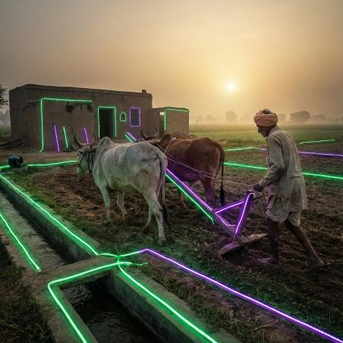
The Challenge Facing Modern Agriculture
Farmers today face unprecedented challenges in an increasingly complex agricultural landscape. Access to timely information, fair markets, and expert guidance remains limited, especially for smallholder farmers in rural areas. Traditional farming methods, while valuable, need support from modern technology to maximize yields and profitability.
Weather unpredictability, market price fluctuations, crop diseases, and limited access to government schemes create barriers to success. Many farmers lack the tools to make data-driven decisions about what to plant, when to harvest, and where to sell. This information gap can mean the difference between a profitable season and significant losses.
FarmSetu bridges this gap by bringing essential agricultural tools, resources, and community support directly to farmers' fingertips. Our platform democratizes access to technology and expertise, ensuring every farmer—regardless of size or location—has the resources needed to thrive in today's agricultural economy.

Slide 3




FarmSetu Platform Overview
FarmSetu is more than just a farming app—it's a complete digital ecosystem designed with farmers at the center. Our platform integrates multiple essential services into one seamless experience, from buying and selling agricultural supplies to connecting with experts and predicting crop yields using advanced machine learning.
Digital Marketplace
Expert Network
Buy and sell farming resources including tools, seeds, and fertilizers in a trusted community marketplace
Connect instantly with agricultural experts and fellow farmers for guidance and community support
Market Intelligence
AI-Powered Tools
Access real-time market analysis with price trends and profitability insights for informed decision-making
Leverage machine learning for crop recommendations, disease detection, yield prediction, and rainfall forecasting
Every feature is designed with practical farming needs in mind, ensuring the technology serves the farmer—not the other way around. The platform supports multiple Indian languages, making it accessible to farmers across diverse linguistic regions. Whether you're managing a small family farm or overseeing commercial operations, FarmSetu adapts to your specific needs and circumstances.

Slide 4
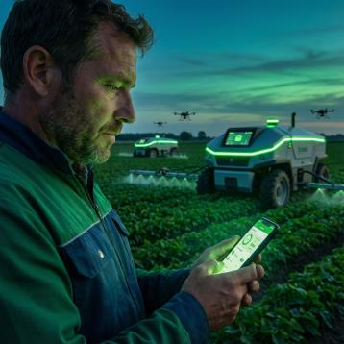

Marketplace & Trading Hub
Connect. Trade. Grow.
The FarmSetu Marketplace revolutionizes how farmers access and exchange agricultural resources. Our digital trading platform creates a transparent, efficient marketplace where farmers can buy quality inputs and sell surplus resources directly to other farmers, eliminating unnecessary middlemen and reducing costs.
Key Features:
Browse and purchase seeds, fertilizers, pesticides, and farming tools from verified sellers
List your own surplus resources for sale with easy-to-use posting tools
Compare prices across multiple sellers to ensure you're getting fair market value
Read reviews and ratings from other farmers to make informed purchasing decisions
Secure payment processing and transaction tracking for peace of mind
Location-based search to find resources available near your farm
The marketplace operates on trust and transparency. Every transaction is recorded, and both buyers and sellers can leave feedback, building a reputation system that rewards quality and reliability. This community-driven approach ensures farmers can trade with confidence, knowing they're working within a network that values integrity and fair dealing.
Real Impact: Farmers report saving an average of 15-20% on input costs by purchasing directly through the FarmSetu marketplace, while sellers gain access to a wider customer base without additional marketing expenses.

Slide 5



Expert Consultation & Community Connection
Chat with Agricultural Experts
One-on-One Farmer Connections
Community Forum
Participate in broader discussions through public posts visible to all members. Share success stories, ask questions, and learn from the collective wisdom of thousands of farmers
Get instant answers to your farming questions through our AI-powered chatbot, available 24/7 to provide guidance on crop management, pest control, soil health, and farming best practices
Connect directly with fellow farmers for peer-to-peer knowledge sharing, advice on local conditions, and collaborative problem-solving within your agricultural community
Agriculture thrives on shared knowledge and community support. FarmSetu creates multiple channels for farmers to connect, learn, and grow together. Whether you need quick answers from our AI expert system, want to chat privately with an experienced farmer facing similar challenges, or wish to contribute to community discussions, the platform provides the tools to build meaningful agricultural networks.
Knowledge sharing accelerates innovation. When farmers connect and collaborate, everyone benefits from collective experience and local expertise that no single resource could provide.

Slide 6
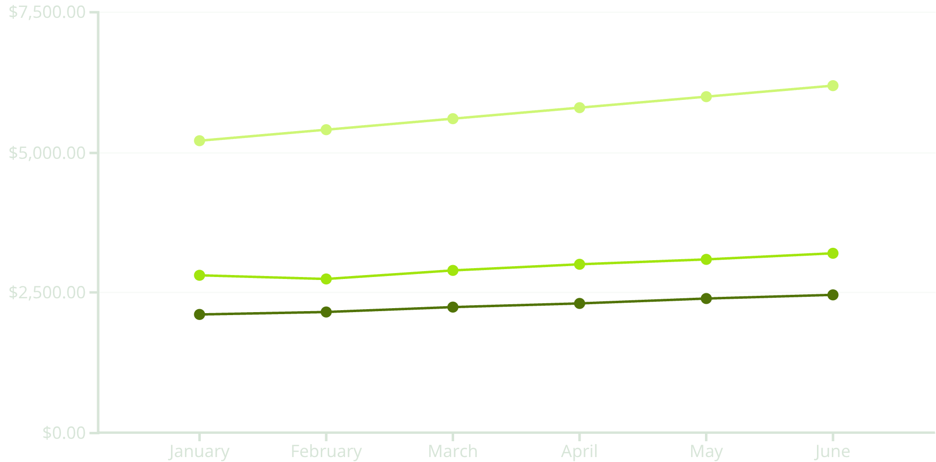
Real-Time Market Analysis & Intelligence
Make Data-Driven Decisions
Understanding market conditions is crucial for maximizing farm profitability. FarmSetu's Real-Time Market Analysis provides comprehensive insights into crop prices, market trends, and profitability forecasts, empowering farmers to make informed decisions about what to plant, when to harvest, and where to sell.
Platform Capabilities:
Live price updates for major crops across different markets and regions
Historical trend analysis showing weekly, monthly, and yearly price patterns
Profit and loss projections based on current market conditions
Interactive charts and graphs for easy data visualization
Market alerts and notifications for significant price movements
Comparative analysis across different crops to optimize planting decisions
Wheat
Rice
Cotton
The platform aggregates data from multiple sources, providing a comprehensive view of market dynamics. Farmers can track specific crops relevant to their operations and receive customized insights based on their location and farming practices.
Sample market trends showing price movements across key agricultural commodities. Access real-time data for hundreds of crops on the FarmSetu platform.

Slide 7
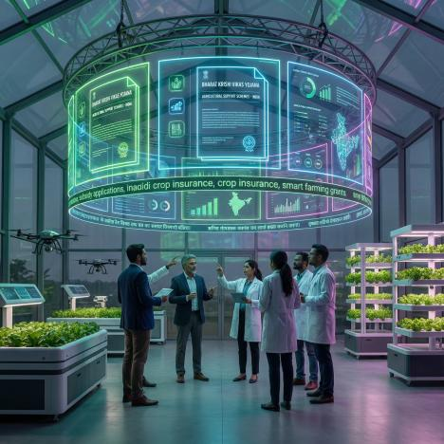
Comprehensive Information & Resource Hub
Weather Monitoring
Latest Agriculture News
Educational Resources
Stay ahead of weather conditions with localized forecasts and severe weather alerts. Receive timely notifications about rainfall, temperature changes, and adverse conditions that could impact your crops, allowing proactive farm management.
Keep up-to-date with the latest farming innovations, technologies, market developments, and policy changes. Our curated news feed ensures you never miss important information that could benefit your farming operations.
Access comprehensive learning materials including video lectures, tutorials, and guides on modern farming techniques. Continuous education empowers farmers to adopt new technologies and improve their agricultural practices.
Government Schemes & Insurance
Navigate the complex landscape of government agricultural programs with ease. FarmSetu provides detailed information about various schemes designed to support farmers, including subsidies, loans, and assistance programs. We break down eligibility requirements, application processes, and benefits in simple language.
Understanding insurance options is equally crucial for risk management. Our platform explains available crop insurance schemes, helping farmers protect their investments against natural disasters, pest infestations, and market fluctuations.

Slide 8
AI-Powered Agricultural Intelligence
FarmSetu leverages cutting-edge machine learning technology to provide farmers with predictive insights and intelligent recommendations. Our AI models analyze vast amounts of agricultural data to help you make smarter farming decisions, reduce risks, and maximize yields.
1
2
Crop Recommendation System
Rainfall Prediction Model
Input your soil parameters—including pH levels, humidity, water availability, and temperature—and receive AI-powered recommendations for the most suitable crops for your land. Our machine learning model considers multiple factors to suggest crops with the highest potential for success and profitability in your specific conditions.
Advanced forecasting predicts rainfall across India within 24, 48, and 72-hour windows. The system automatically alerts farmers to open or close irrigation valves based on predicted rainfall, optimizing water usage and preventing over-irrigation. Smart water management saves resources and improves crop health.
3
4
Crop Disease Detection
Yield Prediction Analytics
Simply photograph a crop leaf and upload it to the platform. Our image recognition AI analyzes the photo to detect diseases, identifying problems early when they're most treatable. The system not only diagnoses issues but also provides specific treatment recommendations and preventive measures to protect your entire crop.
Input details about your location (state, district, city), land area, fertilizer usage, and pesticide application. Our model processes this data to predict expected crop yield in tons, helping you plan harvest logistics, storage needs, and market strategies. Accurate yield forecasting enables better business planning and resource allocation.
Machine Learning Advantage: Our AI models continuously improve through use, learning from millions of data points across India's diverse agricultural regions to provide increasingly accurate recommendations and predictions.

Slide 9

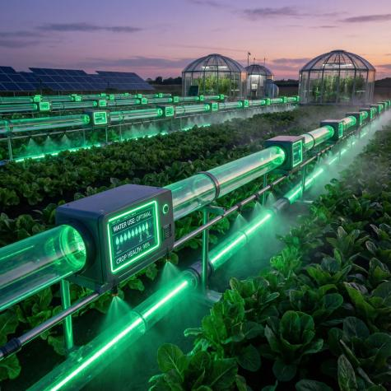
Personalized Dashboards & Management Tools
Farmer Dashboard
Admin Dashboard & Water Management
Every farmer on FarmSetu receives a personalized dashboard tailored to their specific needs and operations. The intuitive interface provides a comprehensive overview of all farm activities and platform features in one centralized location.
FarmSetu includes sophisticated administrative tools for managing shared agricultural resources, particularly water distribution systems. The admin dashboard enables efficient resource allocation and fair access management.
Dashboard Features Include:
Digital Parchi/Bari System:
Add, edit, update, and delete farm data and crop information
Farmers submit water requests through the platform
Track multiple fields and crop cycles simultaneously
Administrators review and approve requests based on availability and need
Monitor irrigation schedules and water usage
Automated turn assignment ensures fair distribution
View recommended actions based on weather and market conditions
Real-time notifications inform farmers of their scheduled water access
Access quick links to marketplace, experts, and resources
Admins can add and manage multiple water sources
Review transaction history and marketplace activity
Usage tracking and reporting for accountability
Manage profile settings and notification preferences
This digitized system replaces traditional paper-based methods, reducing conflicts, improving transparency, and ensuring equitable resource distribution across farming communities. The platform maintains complete audit trails for all water allocation decisions.
The dashboard serves as your agricultural command center, organizing complex information into actionable insights that help you manage daily operations efficiently.

Slide 10

Built for India's Farmers, in India's Languages
16+
20+
24/7
Platform Features
Indian Languages
Expert Access
Comprehensive tools covering every aspect of modern farming operations
Multi-language support ensuring accessibility across all regions
Round-the-clock AI support with instant answers to farming questions
Language is not a barrier to agricultural progress
FarmSetu proudly supports multiple native Indian languages, ensuring that every farmer can access our platform in their preferred language. From Hindi and Bengali to Tamil, Telugu, Marathi, Gujarati, and many more, we've built true linguistic inclusivity into every aspect of the platform.
This commitment to multilingual support means that farmers across India—regardless of their educational background or primary language—can benefit from advanced agricultural technology. Instructions, recommendations, market data, and community discussions are all available in regional languages, making FarmSetu truly accessible to the millions of farmers who drive India's agricultural economy.
Technology should empower everyone, not create new barriers. By speaking your language, FarmSetu ensures that innovation reaches every corner of India's diverse agricultural landscape.
Join the FarmSetu Revolution
FarmSetu represents more than just agricultural technology—it's a movement toward empowered, informed, and connected farming communities. By combining marketplace efficiency, expert knowledge, real-time intelligence, and AI-powered insights into one comprehensive platform, we're helping farmers make better decisions, increase profitability, and build sustainable agricultural futures.
Whether you're a smallholder farmer managing a few acres or an agri-extension worker supporting entire communities, FarmSetu provides the digital tools you need to succeed in modern agriculture. Our platform grows with you, continuously adding new features and improving existing ones based on farmer feedback and technological advances.
The future of Indian agriculture is digital, connected, and intelligent. Welcome to FarmSetu—where tradition meets innovation, and farmers lead the way forward.

